Slide 1


PHARMA HUB
PROJECT REPORT
Submitted in Project of B. Tech
in
Computer Science Engineering
under
Punjabi University, Patiala
Submitted by
Nitin Garg
22301115

Slide 2
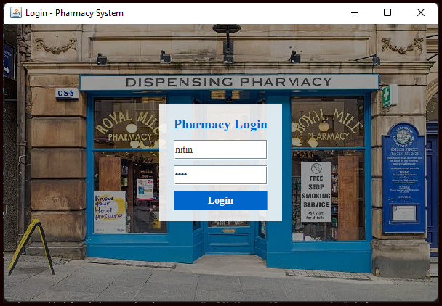
LOGIN WINDOW
The Login Window class serves as the entry point to the system, ensuring that only authorized users can access the application. Two types of users are defined in the current version — the Admin and the Pharmacist. The admin user has full control over the system, including the ability to add new items to the inventory and modify existing records, while the pharmacist has limited access, restricted to viewing and billing operations.

Slide 3
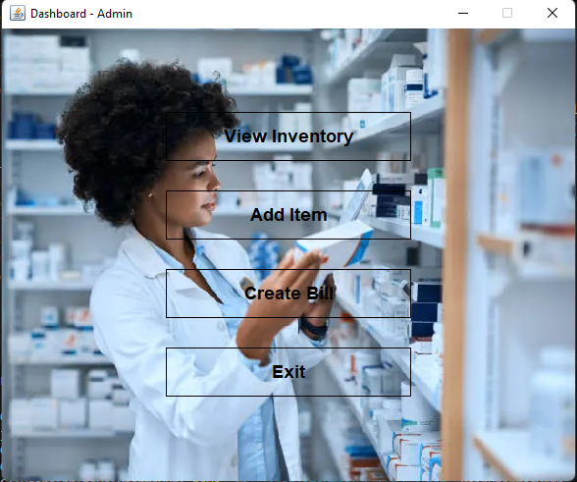
MAIN MENU WINDOW
The MainMenuWindow serves as the hub from which users can navigate to different functional areas of the application. It presents a clean and organized interface with large, easily accessible buttons for key operations — “View Inventory,” “Add Item,” “Create Bill,” and “Exit.” When we can Login through Admin we can use Add Item but if we can Login through Pharmacist we cannot use Add Item button in it.

Slide 4
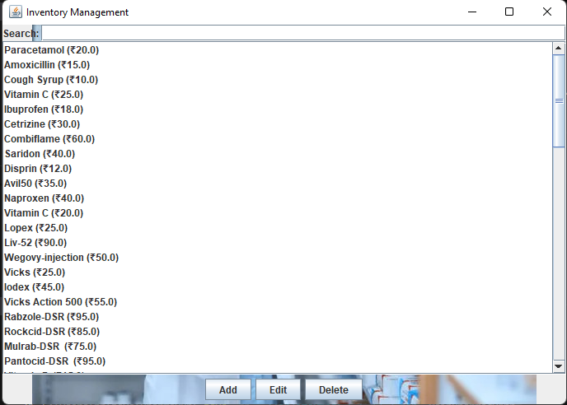
INVENTORY WINDOW
The Inventory Window is one of the most crucial modules in the Pharma Hub system, designed to handle all aspects of inventory management. It displays the current list of medicines available in the store, along with details such as price. The window employs a JList component to show the medicines in a scrollable format, while a DefaultListModel dynamically updates the list whenever changes are made. The design includes a real-time search feature, allowing users to quickly locate medicines by typing partial or full names into a search bar. This enhances user efficiency and eliminates the need for manual scrolling through long lists. The Inventory Window also supports CRUD (Create, Read, Update, Delete) operations.

Slide 5
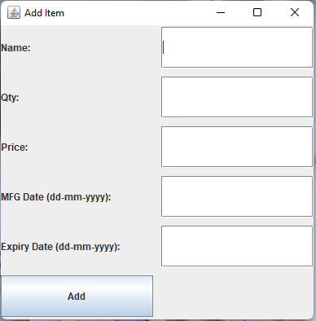
ADD ITEM WINDOW
The Add Item Window module allows the admin to introduce new medicines into the inventory. Its design follows a simple, grid-based layout with labeled text fields for each attribute — name, quantity, price, manufacture date, and expiry date. A dedicated “Add” button processes the input, validates the data, and updates the centralized inventory list. The window also includes a status label that provides immediate feedback to the user, such as “Item Added Successfully” or “Error: Invalid Input.”

Slide 6
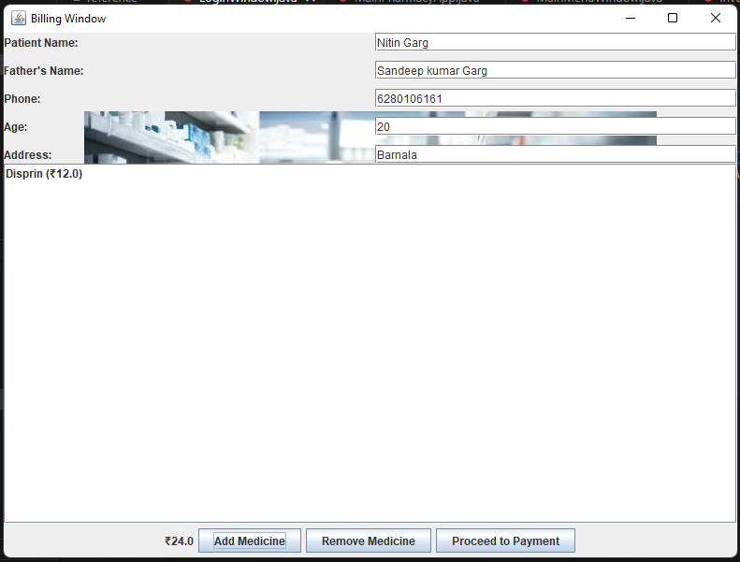
BILLING WINDOW
The BillingWindow handles the entire sales process — adding medicines, calculating totals with GST, collecting customer details, and generating professional invoices using iText PDF, saved in a “bills” folder. It also manages real-time stock updates, preventing over-selling and restoring inventory when items are removed. Overall, it integrates billing, PDF generation, and inventory control in one system.

Slide 7
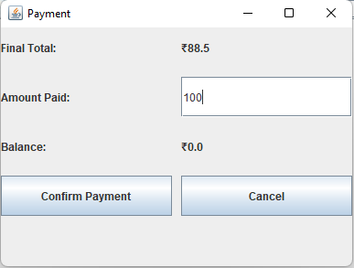
PAYMENT WINDOW
The Payment Window, which manages the financial transaction aspect of the sale. It prompts the user to enter the amount received from the customer and automatically calculates the balance or change to be returned. The payment is currently handled in cash mode for simplicity. Once the payment is confirmed, the system calls back to the Billing Window, triggering the PDF generation process. This modular interaction between Payment Window and Billing Window exemplifies the use of callback functions to facilitate smooth inter-class communication without tightly coupling the components.

Slide 8
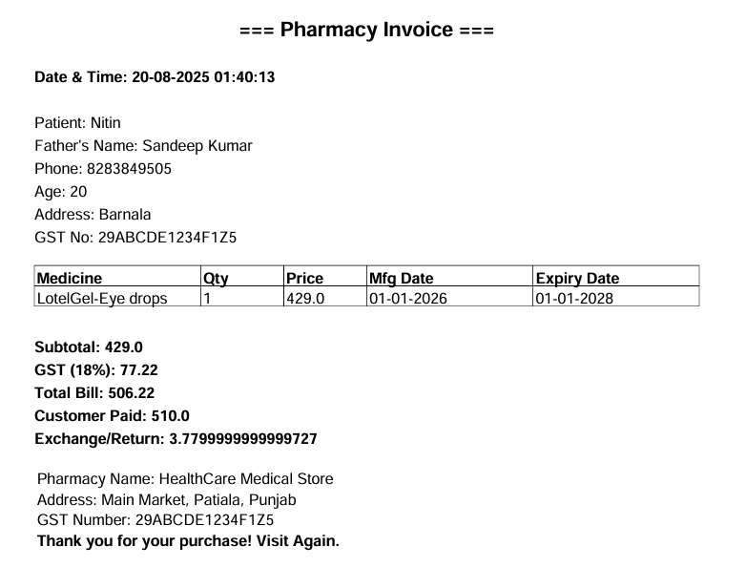
BILL IN PDF FORM
This is a sample pharmacy invoice generated automatically by the system using the iText PDF library. The bill includes the date and time of purchase, complete customer details such as name, father’s name, phone number, age, and address, along with the pharmacy’s GST number. It presents a neatly formatted table showing the medicine name, quantity, price, and its manufacturing and expiry dates. The invoice also calculates the subtotal, GST, total bill amount, the amount paid by the customer, and the balance or return amount. This PDF invoice ensures professional billing, accurate calculations, and proper digital recordkeeping for every transaction.

Slide 9
TECHNOLOGIES USED
PHARMA HUB
JAVA PROGRAMMING
JAVA SWING
EVENT HANDLING
ITEXT LIBRARY
CORE LANGUAGE OF THE SYSTEM
FOLLOWS OOPS CONCEPTS
PLATFORM INDEPENDENT THROUGH JVM
USED TO BUILT ALL APPLICATION WINDOWS
CUSTOM BACKGROUND PANELS FOR BETTER UI
ACTION LISTENER FOR BUTTON CLICKS
ENABLES DYNAMIC AND INTERACTIVE USER ACTIONS
GENERATES PROFESSIONAL INVOICES PDFs
INCLUDES MEDICINES ,GST,TOTALS, CUSTOMER DETAILS

Slide 10
ADVANTAGES
Real-Time Inventory Updates – Stock instantly increases or decreases based on sales and cart actions.
Professional PDF Invoice Generation – Creates clean, detailed bills using the iText library.
User-Friendly Interface – Simple and easy-to-use Java Swing GUI for smooth operation.
Secure User Authentication – Only authorized users can log in and access system features.
Fast and Accurate Billing – Automatically calculates totals, GST, and balance, reducing human errors.
ADVANTAGES

Slide 11
DISADVANTAGES
No Permanent Database – Uses in-memory storage, so data is lost when the application closes.
Single-System Usage – Cannot be accessed from multiple computers at the same time.
Limited Scalability – Not suitable for large pharmacies with high-volume inventory.
Requires Java Installation – The system runs only on devices with Java and the required libraries installed.
No Cloud Backup – Bills and data are stored locally, risking data loss if the system crashes.
DISADVANTAGES

Slide 12

FUTURE SCOPE
Add a Permanent Database – Use MySQL or PostgreSQL to store data safely and avoid loss when the system closes.
Implement Cloud Support – Allow multiple computers and branches to access the same pharmacy data in real time.
Introduce Barcode/QR Scanning – Speed up billing and reduce manual typing by scanning medicine codes.
Add Low-Stock & Expiry Alerts – Notify the pharmacist automatically about items that are about to expire or finish.
Develop a Mobile App/Online Ordering System – Allow customers to order medicines online and check availability.

Slide 13


Slide 14


